Slide 1
Bellabeat Fitness Data Analysis Case Study
Satish | Data Analytics Capstone Project
4/27/2026

Slide 2
Business Problem
Bellabeat is a wellness tech company focused on women’s health
The company wants to understand how users interact with smart wellness devices to improve marketing strategy and product engagement
We used Fitbit data as a proxy for user behavior in fitness trackers

Slide 3
Dataset Overview
The dataset include
35 users of Fitbit
1,300+ daily records
Daily activity (steps, calories, intensity)
Sleep activity (duration, time in bed)

Slide 4
Data Preparation
Combined two datasets (different time periods)
Cleaned data
Checked duplicates and structure
Created activity level categories (sedentary → very active)
Created new feature: HoursAsleep from MinutesAsleep
Merged sleep and activity datasets using Id for combined analysis
Used Matplotlib to create visualizations for trends and insights

Slide 5
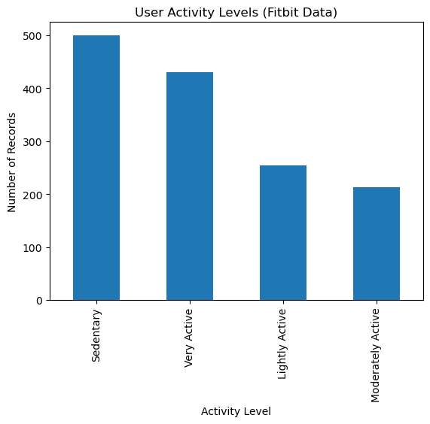
Activity Behavior
Majority of time is spent in sedentary behavior
Very active periods are also highly frequent
Users show two dominant behavior patterns: long periods of inactivity and short bursts of high intensity activity

Slide 6
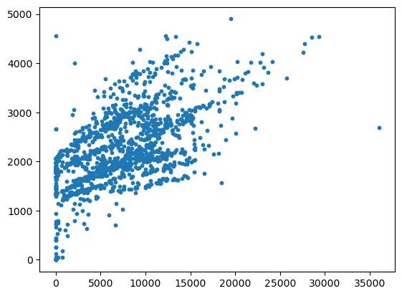
Steps vs. Calories
Positive relationship between steps and calories burned
More activity = higher energy expenditure

Slide 7
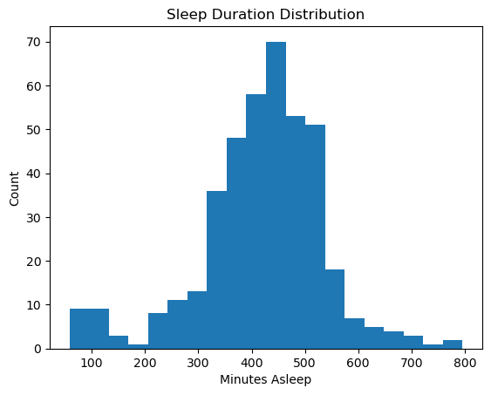
Sleep Behavior
Average sleep duration: ~7 hours (419 minutes)
Sleep ranges from ~1 to 13 hours
High variability in sleep patterns across users
Presence of a few extreme outliers

Slide 8
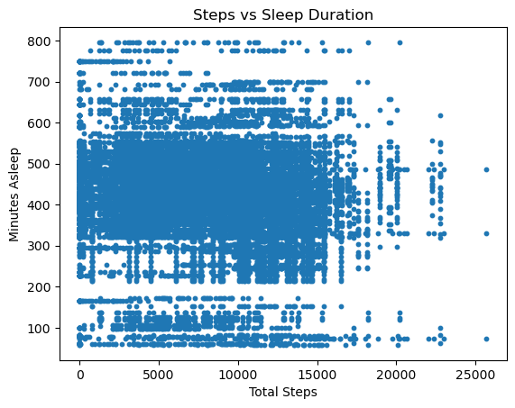
Sleep vs Activity
Relationship
No strong correlation between steps and sleep duration
Activity levels do not predict sleep quality
Data points are widely scattered with no clear pattern

Slide 9
Key Findings
Users are mostly sedentary across the dataset
Activity levels are inconsistent across days
Some users are highly active, but not the majority
No strong relationship between activity and sleep behavior
Activity and sleep patterns vary significantly across users

Slide 10
Business Recommendations
Integrate sleep + activity tracking into unified wellness insights
Provide personalized recommendations based on behavior patterns
Encourage habit-building for both movement and sleep consistency
Segment users based on lifestyle patterns for targeted engagement

Slide 11
Fitbit Fitness Tracker Data (Kaggle)
https://www.kaggle.com/datasets/arashnic/fitbit
Bellabeat case study materials (Google Data Analytics Certificate)
References

